Slide 1


Practical Online Strategies for Community-Based Learning
Donna M. Fahey
Director, Boccolini institute
Notes:
Welcome and thank you for being here today. In this session we will talk about practical online strategies that work in community-based settings, such as healthcare, acute, post-acute, long-term care, local agencies, environments where time is limited, budgets are tight, and engagement is tied to high states outcomes such as patient safety and health outcomes.

Slide 2
Learning Objectives
By the end of this session, learners will be able to :
Explain the structural barriers that limit engagement in community-based learning environments
Apply the CARE Loop to design learning that strengthens transfer, reinforcement, efficiency, and persistence
Develop a scalable engagement strategy that can be piloted within 30 days in their own setting
Notes:
By the end of this session, participants will be able to: Explain the structural barriers that limit engagement in community-based learning environments. Apply the CARE Loop to design learning that strengthens transfer, reinforcement, efficiency, and persistence. And Develop a scalable engagement strategy that can be piloted within 30 days in their own setting.

Slide 3
Session Road Map
Why Engagement Breaks Down in Community-Based Learning
The CARE Loop Framework
Four Engagement Strategies
  Scenario-Based Learning
  Microlearning & Spacing
  Personalization
  Gamification
Scaling for Sustainable Impact
Notes:
This presentation builds on what I call the Higher Ed Advantage. Higher education has invested heavily in LMS architecture, gamification models, online feedback systems, and interactive design. Universities do online learning well.
Community-based organizations do not need to adopt the full university model — but they can borrow its design strengths. Let me briefly walk you through where we’re going. We’ll begin by looking at why engagement so often breaks down in community-based learning environments — not because people don’t care, but because structural constraints make traditional online design ineffective. From there, I’ll introduce the CARE Loop and the Engagement Lens — the framework we use to design learning that is contextualized, active, reinforced, and efficient. Then we’ll move into four practical strategies, in a deliberate order. First, scenario-based learning — because if learning doesn’t transfer to real-world decisions, nothing else matters. Second, microlearning and spaced reinforcement — because time is limited, and retention requires repetition under low cognitive load. Third, personalization — because community learners vary widely in experience, preparation, and digital confidence, and efficiency requires thoughtful differentiation. And finally, gamification — not as entertainment, but as a structured way to engineer persistence and visible progress. We’ll close with a simple method for scaling these approaches, so they move beyond one-time initiatives and become part of sustainable practice. My goal is that you leave not just with ideas, but with a design structure you can pilot within the next 30 days.

Slide 4
A Real Moment
6:45 pm
End of a 12-hour shift
A Family in the hallway
A patient with changing respirations
Exposure vs. Reinforcement
Notes:
Before we move into the framework, let me ground this in a real moment. It’s 6:45 p.m. A nurse is finishing a twelve-hour shift. She has one more chart to complete. A family is asking questions in the hallway. A patient’s breathing has changed in the last hour. Earlier that week, she attended a one-hour education session on end-of-life symptom management. It was thorough. Evidence-based. Well designed. But in this moment, she doesn’t remember the slides.
She remembers the one scenario she had to decide through — a communication technique that now helps her respond to the anxious family in the hallway. She remembers the short follow-up question she received two days later — and it guides what she does next for the patient whose respirations have changed. That is what intentional design looks like in practice. That is the difference between exposure and reinforcement.

Slide 5

Community-Based Learning Realities
Time scarcity and workflow interruptions
Learner diversity in background and preparation
Compliance fatigue and mandatory training overload
Low tolerance for “extra clicks”
Limited instructional design infrastructure
Notes:
Community-based learning operates under conditions very different from a traditional university semester. On this slide, I outline five realities that shape community-based online learning. First, time scarcity and workflow interruptions. Learners are not blocking off study time the way traditional students might. They’re fitting training in before a shift, between patient visits, or at the end of an emotionally demanding day. Their learning is constantly interrupted. Second, learner diversity in background and preparation. In community settings, we may be teaching physicians, nurses, aides, volunteers, and administrative staff in the same system. Educational background, digital comfort, and professional experience vary widely. That variability affects how training is received. Third, compliance fatigue and mandatory training overload. Many organizations layer required module on top of required module. Professional development often becomes a series of static, checkbox-style trainings with minimal interaction. A recent systematic scoping review by Chaker and colleagues in 2024 found that while online continuing education can improve knowledge and confidence, engagement and design quality significantly influence outcomes. In other words, delivery alone isn’t enough — how we design matters. Fourth, there is a low tolerance for “extra clicks.” If learners encounter unnecessary steps, redundant slides, or inefficient navigation, frustration increases quickly. Efficiency is not a luxury in these settings — it is essential. And finally, limited instructional design infrastructure. Many community organizations operate under budget constraints with limited access to dedicated instructional designers. There may also be technology hesitancy and a strong compliance-driven training culture that prioritizes completion over engagement. I’ve included an image on this slide of a healthcare provider sitting in front of a computer with her head in her hands. She appears distressed or overwhelmed. The image represents the lived reality many frontline staff experience when training feels like one more demand in an already demanding day. In this environment, engagement is not about making learning flashy. It is about making it meaningful, relevant, and efficient. If we waste their time, we lose them. If we respect their time, we earn their attention.

Slide 6
Pause and Reflect
What is one engagement strategy in your online environment that would still work even if the technology changed?
Notes:
Let's pause a moment to reflect - What is one engagement strategy in your online environment that would still work even if the technology changed?

Slide 7

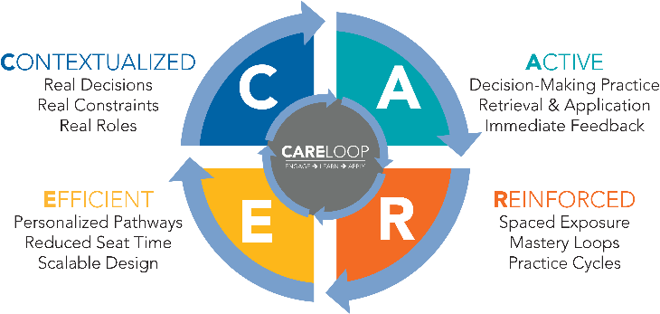

Notes:
On this slide, you see a circular framework titled “The CARE Loop: A Design Framework for Community-Based Online Learning.” The graphic is organized as a four-part circle divided into quadrants, each representing one core design principle. At the center of the circle are the words: Engage, Learn, Apply, indicating that the purpose of the loop is to move learners through meaningful engagement toward real-world application. Let me walk you through each quadrant. The first quadrant, labeled C for Contextualized, emphasizes real decisions, real constraints, and real roles. This means learning should reflect the actual environment learners work in. It should mirror their daily realities — not abstract, idealized situations. The second quadrant, labeled A for Active, focuses on decision-making practice, retrieval and application, and immediate feedback. This is where learners are required to think, choose, and apply — not just consume information passively. The third quadrant, labeled R for Reinforced, highlights spaced exposure, mastery loops, and practice cycles. This means learning doesn’t happen once and disappear. It repeats, builds, and strengthens over time. The fourth quadrant, labeled E for Efficient, emphasizes personalized pathways, reduced seat time, and scalable design. In community-based settings, efficiency isn’t optional. It is essential. Learning must respect time constraints while still being meaningful. The circular arrows in the graphic show that this is not a linear checklist. It is a loop. Each component strengthens the others. Context makes activity meaningful. Activity supports reinforcement. Reinforcement improves efficiency. And efficiency makes contextualization sustainable. At the bottom of the slide, you’ll see a scaling pathway labeled “Scaling and Improvement.” It includes four steps: Pilot, Measure, Refine, Sustain. This reminds us that effective online learning design is iterative. We test small, gather data, improve intentionally, and then scale. The CARE Loop gives us a practical way to think about engagement design in resource-constrained environments. It keeps us focused on what matters: engaging learners in real-world thinking, reinforcing learning over time, and doing it efficiently enough to scale.

Slide 8

Engagement as the Engine
Reduces unnecessary cognitive load
Increases real-world relevance
Creates feedback loops that strengthen transfer
Supports diverse learners - multiple means of engagement
Engagement is the design condition that determines whether learning translates
Cognitive – Emotional – Behavioral - Social
Notes:
If the CARE Loop provides the structure, this slide focuses on the engine that drives it: engagement. “Engagement is the design condition that determines whether learning translates.” That line captures the core idea here.
Visually, the slide includes an image of a car engine start button. The engine image reinforces the metaphor — engagement is what powers the system. Without it, the structure doesn’t move. On the slide, I outline four ways engagement functions in design. First, it reduces unnecessary cognitive load. That means we remove clutter, redundancy, and excessive information that overwhelms working memory. Cognitive Load Theory reminds us that when mental bandwidth is overloaded, learning suffers. Second, engagement increases real-world relevance. Learning must connect directly to the decisions learners actually face. This is where adult learning theory and Self-Determination Theory intersect — relevance and autonomy increase persistence and motivation. Third, engagement creates feedback loops that strengthen transfer. When learners retrieve information, apply it, and receive immediate feedback, retention improves. Retrieval practice research strongly supports this behavioral dimension of engagement. And fourth, engagement supports diverse learners through multiple means of engagement.
Universal Design for Learning emphasizes that learners differ in background, confidence, and motivation. Designing multiple ways to engage supports equity and inclusion in community-based environments. At the bottom of the slide, you’ll see four words: Cognitive – Emotional – Behavioral – Social. When we design online learning, we are intentionally engineering these four forms of engagement. Cognitive engagement is about thinking deeply and solving problems. Behavioral engagement is about taking action and practicing. Emotional engagement is about relevance, meaning, and motivation. Social engagement is about belonging and professional identity. Research supports this framing. A U.S. Department of Education meta-analysis found that online learning outcomes were stronger not because content was digital, but because interactive elements were embedded into the design. Instructional quality was the key variable. That finding, along with work by Meyer, Rose, and Gordon on Universal Design for Learning and research on online persistence, reinforces that engagement is not decoration layered onto content. It is the condition that determines whether learning translates into practice. Engagement predicts persistence. Persistence predicts completion. Completion predicts competence. In community-based settings, where stakes are high and time is scarce, that chain matters.

Slide 9
Evidence Anchor
Engagement Drives Impact
Online professional education is effective; instructional design quality determines impact (Cook, 2013)
Interaction elements (decision-making, feedback, application) improve outcomes in online settings (Means, 2010)
Scenario and simulation-based learning strengthen confidence and decision transfer in healthcare education (Sitzmann, 2011).
Microlearning improves retention when paired with retrieval and spaced reinforcement (Garcia-Garcia, 2024).
Adaptive and personalized pathways can increase efficiency when aligned to defined competencies (Van Merrienboer, 2018).
Notes:
Before we move into specific strategies, I want to briefly anchor this in research. On this slide, I highlight five key findings. First, online professional education is effective — but instructional design quality determines impact.
Cook’s work in health professions education shows that outcomes depend less on modality and more on how the learning is structured. Second, interaction improves outcomes. Means and colleagues found that online learners performed better when courses included decision-making, feedback, and application. It wasn’t “online” that made the difference — it was interaction. Third, scenario and simulation-based learning strengthen confidence and decision transfer, especially in healthcare settings. Sitzmann’s meta-analysis supports this clearly. Fourth, microlearning improves retention when paired with retrieval and spaced reinforcement. Short segments alone are not enough — practice and repetition matter. And finally, adaptive and personalized pathways increase efficiency when aligned to defined competencies. As Van Merriënboer’s work suggests, personalization must be intentional and competency-driven. The through-line across all of this is simple: Design determines impact. When we embed interaction, practice, reinforcement, and personalization, online learning becomes effective — not just accessible.

Slide 10
Four Engagement Strategies
Strategy | Why It Works | Evidence Anchor | Implementation | Measurement
Scenario-Based Learning | Builds decision-making in realistic context; strengthens transfer to practice | Situated learning; simulation research (Cook et al., 2013) | Convert policy into 3-step branching case with immediate feedback | Scenario accuracy; error patterns; confidence shift
Microlearning + Spacing | Reduces cognitive overload; improves retention through repeated retrieval | Cognitive Load Theory; Spacing Effect (Roediger & Butler, 2011) | Break 60-min module into 6 short units + 1 follow-up question 48 hrs. later | Completion consistency; repeat participation; knowledge retention over time
Personalization | Reduces unnecessary seat time; increases relevance and equity | Universal Design for Learning (Meyer et al., 2014) | Add pre-check quiz to allow skip/refresh pathway | Time-to-completion; placement accuracy; learner satisfaction by role
Gamification | Increases persistence and visible progress; reinforces effort | Motivation & gamification research (Sailer & Hommer, 2017) | Add progress bar + mastery badge tied to performance | Return visits; pathway completion; mastery achievement rates
CARE Alignment: Scenario-Based → Contextualized + Active I Microlearning → Reinforced I Personalization → Efficient I Gamification → Reinforced + Persistence
Notes:
On this slide, I’m showing a summary table that brings together the four strategies we’ll explore. The table has five columns: Strategy, Why It Works, Evidence Anchor, Implementation, and Measurement. I’ll walk through each row briefly so you can hear how these connect. The first row is Scenario-Based Learning. Under “Why It Works,” it notes that this approach builds decision-making in realistic contexts and strengthens transfer to practice.
The evidence anchor references situated learning and simulation research, including Cook and colleagues. For implementation, the example is converting a policy into a three-step branching case with immediate feedback.
And for measurement, you might track scenario accuracy, error patterns, and shifts in learner confidence. The second row is Microlearning plus Spacing. It reduces cognitive overload and improves retention through repeated retrieval. The evidence anchor includes Cognitive Load Theory and the Spacing Effect, including work by Roediger and Butler. Implementation might look like breaking a 60-minute module into six short units, followed by a reinforcement question 48 hours later. Measurement includes completion consistency, repeat participation, and retention over time. The third row is Personalization. This strategy reduces unnecessary seat time and increases relevance and equity. The evidence anchor references Universal Design for Learning, including Meyer, Rose, and Gordon. Implementation could involve adding a pre-check quiz that allows learners to skip or refresh specific pathways.
Measurement might include time-to-completion, placement accuracy, and learner satisfaction by role. And the fourth row is Gamification. Gamification increases persistence and visible progress and reinforces effort. The evidence anchor includes motivation and gamification research, such as Sailer and colleagues. Implementation could include adding a progress bar and tying mastery badges to performance. Measurement might include return visits, pathway completion rates, and mastery achievement. If you look across the table as a whole, you’ll notice a pattern. Each strategy connects theory to practice, practice to measurement, and measurement back to improvement. This isn’t about isolated tactics. It’s about aligning design decisions with outcomes we can observe and improve.

Slide 11

S1 Scenario-Based Learning
Decision Making: Practice choosing the right course of action
Confidence: Build assurance through safe practice
Judgement Under Pressure: Develop critical thinking in time-sensitive situations
Communication Skills: Learn to respond effectively in complex interactions
Notes:
If engagement determines whether learning translates, then transfer begins at the moment of decision. In community-based settings, people aren’t rewarded for recalling information. They’re responsible for making decisions — often under time pressure, emotional complexity, and incomplete information. So the question becomes: Are we designing around content review — or around decision-making? This slide introduces our first strategy: Scenario-Based Learning. On the slide, you’ll see four ways scenario-based learning strengthens practice: First, Decision-Making. Learners practice choosing the right course of action rather than simply recognizing correct answers. Second, Confidence. Safe, structured practice builds assurance before real-world application. Third, Judgment Under Pressure. Scenarios allow learners to think critically in time-sensitive or constrained situations — the conditions they actually work in. And fourth, Communication Skills. Scenarios create opportunities to respond effectively in complex interpersonal interactions. The image on this slide shows healthcare students working with an instructor to practice respiratory resuscitation on an infant manikin. This represents simulation-based learning in action — a safe environment where learners can practice high-stakes decision-making without real-world consequences. Research consistently supports this approach. Studies in health professions education show that scenario-based and simulation-based learning improve knowledge, skill retention, self-confidence, and decision transfer. Even lower-tech, structured branching cases in online environments demonstrate positive effects when designed intentionally. The pattern is clear: When learners must choose, not just review, transfer improves.

Slide 12
Why Scenarios Work
Instead of “What do you remember?” Ask “What do you do?”
Anchors learning in authentic context
Reduces extraneous cognitive load (because it is relevant)
Requires active retrieval and choice
Embeds immediate feedback
Notes:
This slide explains why scenario-based learning works. The first bullet contrasts two questions: Instead of asking, “What do you remember?” we ask, “What do you do?” That shift moves learning from recognition to decision-making.
The next bullet highlights that scenarios anchor learning in authentic context. When knowledge is embedded in real-world conditions, it becomes more usable. Context strengthens transfer. The third bullet notes that scenarios reduce extraneous cognitive load because they are relevant. Learners aren’t sorting through disconnected information. They are focusing on a meaningful decision. The fourth bullet emphasizes that scenarios require active retrieval and choice. Retrieval practice is one of the strongest findings in learning science. When learners must recall and apply knowledge, retention strengthens. And finally, scenarios embed immediate feedback. Feedback corrects error patterns early and reinforces applied judgment. Research in health professions education consistently supports this. Scenario-based and simulation-based learning improve knowledge, skill confidence, and decision transfer — even when delivered through structured, lower-tech branching cases. In short: Relevance reduces overload. Choice activates retrieval. Feedback strengthens transfer. That is why scenarios work — and that’s what we’ll build next

Slide 13
Micro-Scenario Model
Case
Decision
Outcome
Explanation
Next Decision
Case: A person is short of breath. What is your first action?
Decision: (call RN, get oxygen, chart)
Outcome: Provide immediate feedback
Explanation: Explan why the answer is correct/incorrect
Next Decision (progressive difficulty)
Practice critical thinking without real-world consequences
Notes:
On this slide, you’ll see a simple stacked model that outlines the structure of an effective online scenario. The visual looks like a staircase or layered blocks. From top to bottom, the steps are labeled: Case – Decision – Outcome - Explanation - Next Decision. This model is intentionally simple and scalable. It begins with a case — brief, realistic, and focused. On the slide, the example reads: “A person is short of breath. What is your first action?”
Then comes the decision. Learners choose an action — for example: call the RN, get oxygen, or chart. Next is the outcome. The system provides immediate feedback about what happens as a result of that choice. Then comes the explanation. This is where you connect the response to policy, best practice, or clinical reasoning. Correct answers are reinforced. Incorrect answers are corrected. Finally, you offer the next decision. The scenario continues, ideally with progressive difficulty. At the bottom of the slide, you’ll see the phrase: “Practice critical thinking without real-world consequences.” That’s the purpose of this structure. This staircase model operationalizes what we discussed on the previous slide. Each decision point requires retrieval under constraint. In real clinical environments, decisions happen with limited time, incomplete information, emotional pressure, and competing demands. When we design scenarios with realistic limits — brief cases, imperfect options, time pressure — learners aren’t just recalling information. They’re retrieving it while navigating constraints. That is much closer to real practice. And because this structure is modular, you can build it with basic LMS quiz logic or simple branching tools. It doesn’t require high-fidelity simulation to be effective.

Slide 14
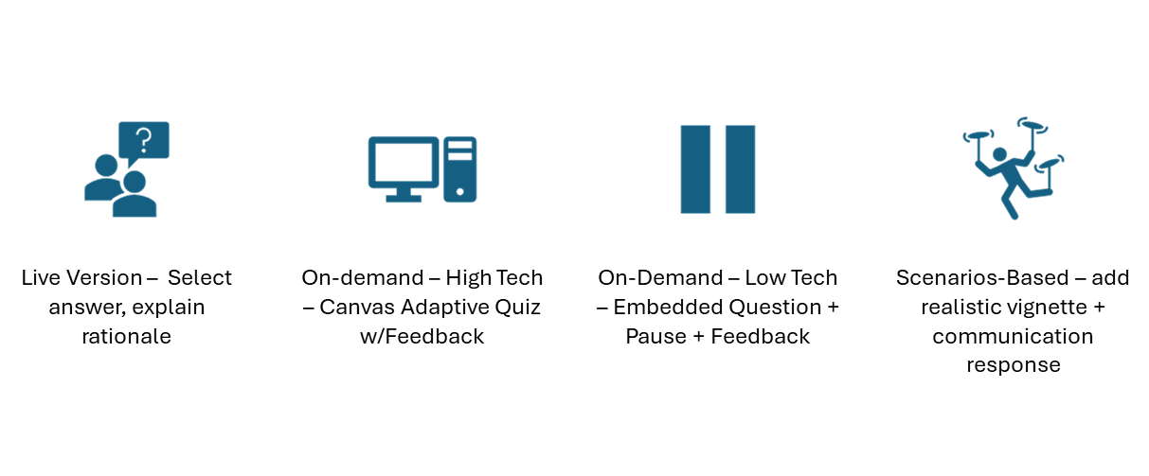
Example: From Live Facilitation to Online Scenario
Active learning requires the learner to think, decide, and receive feedback.
Notes:
This slide shows how a live teaching strategy can be translated into online scenario-based learning. Visually, the slide includes four icons across the top. The first icon shows two people with a question bubble — representing discussion. The second shows a computer — representing digital delivery. The third shows two vertical bars — representing branching or choice. And the fourth shows a figure juggling multiple elements — representing complexity in practice. In the live version of Morphine Myths, I present a statement and ask the audience to decide: Myth or True? The learning happens in the moment they commit to an answer, and I immediately explain the rationale.
To increase engagement in the live setting, I built simple branching in PowerPoint using hyperlinks between slides. Depending on the participant’s response, the slide deck delivers different feedback. It mimics interactive decision-making even without advanced software. In an on-demand environment — such as Canvas or another LMS — the same instructional structure becomes more powerful. The learner sees the statement, selects “Myth” or “True,” and receives immediate, answer-specific feedback. Correct responses are reinforced. Incorrect responses are corrected immediately. The technology allows the system to respond like an instructor in real time. There’s also a low-tech version. I embed the myth statement into a video and ask learners to pause and decide before revealing the answer. Even without interactive branching, requiring a committed response activates retrieval and reflection before feedback is delivered. To deepen this into true scenario-based learning, I add context. For example: You are visiting Mr. Lopez, a hospice patient with advanced COPD. His daughter says, “I don’t want you giving him morphine. Morphine speeds up death.” Now the learner must decide whether that statement is myth or true — and receive immediate clarification. Then I add a follow-up question: What is the best next response? At that point, the learner is practicing not just knowledge recall, but communication and therapeutic response. At the bottom of the slide, you’ll see the key takeaway: Active learning requires the learner to think, decide, and receive feedback. This is formative assessment embedded within instruction. It surfaces misconceptions and corrects them in the moment — before they influence real-world care.

Slide 15
S2 Microlearning
A 3-7-minute learning segment built around a single objective
Designed to fit into real workflows and reinforce learning over time
Working memory is limited, microlearning reduces that load
A single reminder question 48 hours later significantly strengthens retention
Microlearning is a delivery format: retrieval + spacing is the mechanism
Notes:
Scenario-based learning builds context and decision-making. But even a strong scenario is rarely enough after a single exposure. Retention requires reinforcement. That’s where microlearning becomes essential. On this slide, I define microlearning clearly. The first bullet describes it as a 3- to 7-minute learning segment built around a single objective. That focus is critical. One concept. One decision. One skill. The second bullet explains that microlearning is designed to fit into real workflows and reinforce learning over time. In community-based environments, long-form education competes with fatigue, interruptions, and competing demands. Microlearning respects those constraints. The third bullet reminds us that working memory is limited. Cognitive Load Theory, introduced by Sweller, shows that when too much information is delivered at once, retention drops. Microlearning narrows the cognitive load by focusing attention. The fourth bullet states that a single reminder question 48 hours later significantly strengthens retention. This is where spacing matters. When learners re-encounter key ideas through brief prompts or applied questions, they engage in retrieval practice — and retrieval strengthens memory. The final bullet makes an important distinction: Microlearning is a delivery format. Retrieval and spacing are the mechanism.
That distinction is critical. Short content alone does not guarantee learning. Reinforcement does. At the bottom of the slide, I cite recent systematic reviews on microlearning and mobile-based adult learning, along with Sweller’s foundational work on cognitive load. The research consistently shows that short, focused segments improve outcomes when paired with retrieval and spacing. So microlearning is not just shorter content. It is short cycles of reinforcement — focused learning, active recall, and timely feedback — delivered in a way that aligns with how professionals actually work.

Slide 16
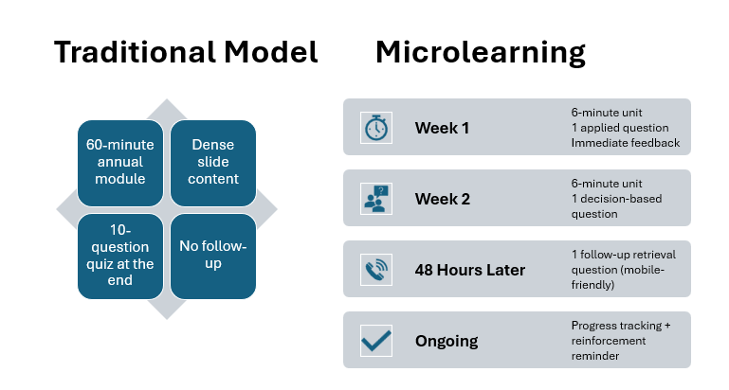
Notes:
This slide compares two approaches to professional education. On the left side, labeled Traditional Model, you see four elements: A 60-minute annual module, Dense slide content, A 10-question quiz at the end, And no follow-up. This model concentrates information into one high-density event. Learners consume a large amount of content at once, complete a quiz, and then move on — often without reinforcement. On the right side, labeled Microlearning, the structure looks very different. In Week 1, there is a 6-minute unit, one applied question, and immediate feedback. In Week 2, another 6-minute unit with a decision-based question. Then 48 hours later, there is a follow-up retrieval question — designed to be mobile-friendly. And finally, an ongoing element that includes progress tracking and reinforcement reminders. What changes here is the rhythm of learning. Instead of a single, dense exposure, learning is distributed across time. Each micro-unit focuses on one concept and one applied decision. Immediate feedback closes the loop. Scheduled retrieval strengthens retention. The goal is not simply shorter content.
The goal is reinforced decision-making practice over time. And that shift — from one-time exposure to distributed reinforcement — is what improves long-term retention.

Slide 17
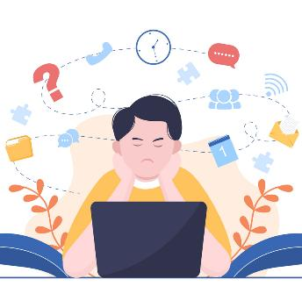
Microlearning Pitfalls
Feedback: Learners don’t know whether they understood the material correctly.
Relevance: Content doesn’t connect to real challenges in their workflow.
Reinforcement: There’s no spaced repetition to strengthen retention.
Application: Learners aren’t given opportunities to practice or apply what they learned.
Too short or fragmented
Notes:
Microlearning is powerful — but only when it is designed intentionally. On this slide, I outline the most common reasons it breaks down. First, Feedback. If learners don’t receive clear, immediate feedback, they don’t know whether they understood the material correctly. Without correction or reinforcement, misconceptions persist. Second, Relevance. If the content doesn’t connect to real challenges in their workflow, it feels disconnected and quickly forgotten.
Third, Reinforcement. Without spaced repetition, learning fades. A short segment delivered once is not microlearning — it’s just brief exposure. Fourth, Application. If learners aren’t asked to practice or apply what they learned, the segment becomes passive consumption rather than active learning. And finally, microlearning fails when it becomes too short or too fragmented. When units lack continuity or narrative structure, learners experience isolated pieces of content rather than a coherent learning arc. The image on this slide shows a person sitting in front of a laptop with a frustrated expression. Around them are floating icons — clocks, question marks, puzzle pieces, chat bubbles — representing distraction and cognitive overload. It illustrates what happens when learning feels fragmented or disconnected. Without feedback, relevance, reinforcement, application, and continuity, microlearning becomes just shorter content — not stronger learning. The goal is not compression. The goal is reinforcement.

Slide 18
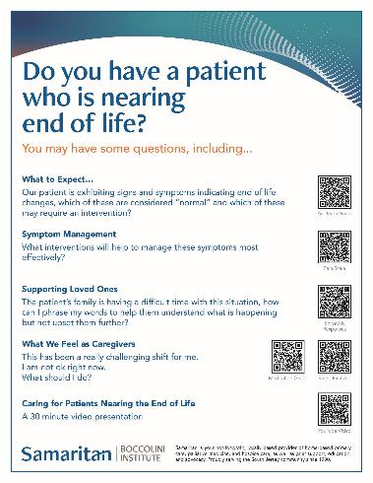
Microlearning
Hospital Partnership
Identified gap in end-of-life clinical confidence
Traditional lecture model → low retention
Designed QR-based just-in-time support
Linked learning to real bedside decisions
Observed behavior shifts + strengthened partnership
Notes:
I’d like to share a practical example of microlearning from hospice education. On this slide, you’ll see a one-page education flyer that we developed. It includes a large headline at the top that reads, “Do you have a patient who is nearing end of life?” Beneath that are several sections with short prompts—such as what to expect, symptom management, supporting loved ones, and what we feel as caregivers. Along the right side are multiple QR codes, each linking to a specific resource, such as symptom protocols, empathetic communication guidance, stress support tools, and a short video. The bullets on this slide summarize the design shift. First, we identified a gap in end-of-life clinical confidence. Hospital clinicians were highly competent, but not always deeply trained in the nuances of active dying, medication titration, or emotionally charged family conversations. Second, our initial response followed the traditional lecture model. We developed a comprehensive session and delivered it multiple times. It was thoughtful and well received — but retention was low. So we reframed the problem. Instead of asking, “How do we teach end-of-life care?” We asked, “What do clinicians need at the moment they are caring for a patient nearing end of life?” That shift led to the third bullet: we designed QR-based just-in-time support. The flyer allowed clinicians to scan a code at the bedside and immediately access a focused resource aligned with the decision they were facing — whether symptom management, communication, or self-regulation. The fourth bullet highlights that we linked learning to real bedside decisions. Instead of relying on memory from a prior lecture, retrieval happened in the workflow. And finally, we observed behavior shifts and strengthened partnership. Over time, we saw fewer inappropriate medication titrations, improved recognition of active dying, and stronger collaboration that ultimately expanded to inpatient hospice services. What this illustrates is that microlearning is not simply about shorter content. It is about reducing cognitive load, embedding retrieval into real practice, and creating reinforcement through repeated exposure during actual patient care. In terms of the CARE Loop, this strengthens the Reinforced dimension — shifting learning from a single educational event to a repeated practice cycle embedded in real work.

Slide 19
S3 Personalization
Personalization
Diverse learners
Role
Confidence
Motivation
Experience
Language & Literacy
Cultural Norms
Different job functions
Self-efficacy levels
Communication needs
Different perspectives
Intrinsic and extrinsic drivers
Novice to expert
Reduces redundancy
Aligns to role
Respects the learner’s time
Strengthens the Efficient dimension of the CARE Loop.
Ensures that learning time is proportional to learning need
Notes:
Microlearning helps reinforce key concepts efficiently. But it still assumes that everyone needs the same reinforcement. In community-based education, that’s rarely true. Learners come from different roles, preparation levels, experience, and confidence with technology. If we force everyone through the same pathway, we create redundancy for some and cognitive overload for others. On this slide, I outline what personalization actually does.
First, it reduces redundancy. Learners don’t need to repeat content they’ve already mastered. Second, it aligns learning to role. A nurse, a hospice aide, and a social worker may all encounter end-of-life care — but their decision points differ. Third, personalization respects the learner’s time. In workforce settings, time is limited. Efficient design is ethical design. Fourth, it strengthens the Efficient dimension of the CARE Loop. Efficiency here means matching learning time to learning need — not cutting content but calibrating it. Universal Design for Learning supports this approach. Multiple pathways increase engagement and promote equity. The citation at the bottom of this slide references a systematic review and meta-analysis in BMJ Open, which found that adaptive e-learning can improve outcomes when aligned to clearly defined competencies. The key is alignment — personalization must be structured, not random. The image on this slide illustrates the competencies or learner variables that inform personalization. These include: Role — different job functions, Confidence — varying levels of self-efficacy, Motivation — intrinsic and extrinsic drivers, Experience — novice to expert, Language and Literacy — communication needs, Cultural Norms — differing perspectives and expectations, Personalization begins by recognizing these differences and designing pathways that reflect them. It is not special treatment. It is proportional learning — aligned to who the learner is and what they need.

Slide 20
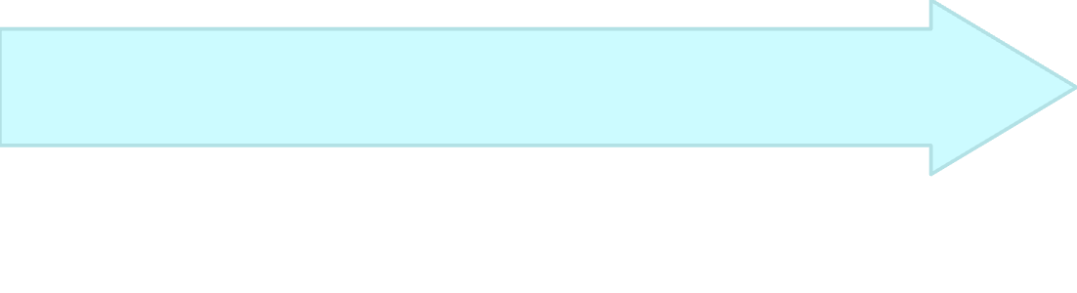
Personalization: Low-Tech to High-Tech
Low-Tech
Mid-Tech
High-Tech
Self-assessment + learner choice of pathway
Optional refreshers / “chose your path” modules
Reflection prompts tied to real practice
Optional pathways based on role or experience
role-based learning pathways
competency checklists + targeted resources
adaptive release based on quiz performance
Adaptive platforms with AI support
adaptive learning platforms that target gaps
AI-supported practice questions and feedback loops
mastery-based progression
Research takeaway: Adaptive learning shows strongest results when tied to:
clearly defined competencies
targeted feedback
appropriate difficulty adjustment
pacing based on mastery
Notes:
This slide illustrates an important point: Personalization is not dependent on high-end software. The slide is organized into three levels: Low, Mid, and High personalization, followed by a research takeaway. Starting with Low-Tech Personalization, the slide lists: Self-assessment plus learner choice of pathway. Optional refreshers or “choose your path” modules. Reflection prompts tied to real practice. This level requires minimal technology. Learners share a common foundation but are given structured choices and opportunities to apply content to their own context. Moving to the Mid-Level, personalization becomes more structured: Optional pathways based on role or experience
Role-based learning tracks. Competency checklists with targeted resources. Adaptive release based on quiz performance
Here, personalization is aligned to defined competencies and learner roles. It becomes more systematic but still achievable within most LMS platforms. At the High-Tech Level, the slide lists: Adaptive platforms with AI support
Systems that target identified gaps. AI-supported practice questions and feedback loops. Mastery-based progression. These systems can reduce time-to-mastery by dynamically adjusting pathways. However, the research takeaway at the bottom of the slide is critical. Adaptive learning shows the strongest results when it is tied to: Clearly defined competencies, Targeted feedback, Appropriate difficulty adjustment, And pacing based on mastery. It is not effective when it simply recommends content like a playlist. The real driver is design. Technology is the delivery mechanism. Start where your resources allow. Even simple personalization improves learner experience and efficiency.
And importantly, personalization does not mean learners work alone. It means they share a common foundation but receive different pathways to mastery. That principle is what we built into the IHPC course model.

Slide 21
Interdisciplinary Hospice & Palliative Care Review (IHPC)
Shared Learning - Builds Teams
Targeted Pathways - Mastery
8-week hybrid model / 10 on-demand modules + 2 live sessions
Interprofessional cohorts (physicians, nurses, social workers, chaplains, aides, administrators)
Shared Core Learning - Team-based hospice foundations
Role-Based Reflection - Domain-specific prompts applied to each learner’s practice / Individual Feedback - Personalized responses + cohort synthesis videos
Discipline-Specific Pathways - Certification blueprint alignment
Gap identification - Targeted study guides & review questions
Notes:
When we talk about personalization in online education, it’s often framed as algorithm-driven adaptive sequencing. But in community-based, interprofessional education, personalization looks different. Let me share an example from our Interdisciplinary Hospice and Palliative Care Review, or IHPC, program. On this slide, the first section is labeled Shared Learning – Builds Teams. IHPC is an eight-week hybrid model that includes: Ten on-demand modules
Two live, four-hour virtual review sessions We’ve enrolled physicians, nurse practitioners, RNs, LPNs, hospice aides, social workers, chaplains, doulas, and administrators — locally and nationally. Everyone learns the same team-based hospice foundations together. That shared core builds interprofessional cohesion. But personalization is layered into the design. The second section of the slide is labeled Targeted Pathways – Mastery. Personalization occurs in three ways. First, Role-Based Reflection. Each module includes domain-specific prompts applied to the learner’s own practice. The content is shared. The meaning-making is personal. Second, Individual Feedback. I respond directly to each learner’s reflection and then provide a short synthesis video for the cohort — highlighting patterns and interdisciplinary insights. This creates personalization through dialogue, not software. Third, Discipline-Specific Pathways. While hospice practice is shared, certification competencies differ by discipline. At the end of the course, each learner receives a mapped pathway aligned to their certification blueprint — including gap identification and targeted study guides and review questions. So the cohort moves through a shared experience, but each learner leaves with a distinct roadmap. This model reduces redundancy, minimizes unnecessary seat time, and focuses effort where mastery is still needed — without fragmenting the team. In community-based education, personalization does not require separating learners. It requires thoughtful design: A shared core, Reflective differentiation, And targeted reinforcement. That is personalization as stewardship.

Slide 22
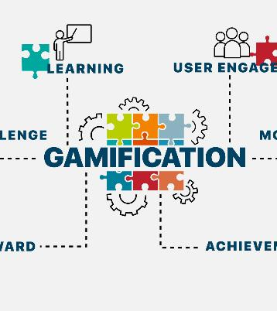
S4 Gamification
Competence “I can master this”
Autonomy “I have meaningful choice”
Relatedness “I belong to a team”
Progress is visible
Behavior is strengthened
Participation is repeated
Progress is motivated
Deci & Ryan, 2000; Dichev & Dicheva, 2017; Li et al., 2024
Notes:
We’ve strengthened contextualization through scenarios. We’ve strengthened reinforcement through microlearning. We’ve strengthened efficiency through personalization. The remaining challenge is persistence. How do we keep learners moving through the loop in high-fatigue clinical environments? That’s where gamification becomes powerful — but only when framed as behavioral design, not entertainment. On this slide, you see the word “Gamification” centered within interlocking puzzle pieces and gears. Around it are words like learning, user engagement, challenge, reward, and achievement. The image reinforces that gamification connects multiple elements — motivation, feedback, and progress — into a functioning system. The bullets on this slide highlight what meaningful gamification supports: Competence — “I can master this.” Autonomy — “I have meaningful choice.” Relatedness — “I belong to a team.” These come directly from Self-Determination Theory. You’ll also see: Progress is visible. Behavior is strengthened. Participation is repeated. Progress is motivated. Points alone are weak. Points without performance feedback produce minimal impact. The research is clear. Meta-analyses by Sailer, Hamari, and others show that gamification improves motivation and learning outcomes when elements reinforce competence and autonomy. Dichev and Dicheva caution that poorly aligned mechanics — points without meaning — have little effect. And recent work by Li and colleagues confirms that intrinsic motivation increases when autonomy and relatedness are supported. So in community healthcare education, gamification is not play for play’s sake. It is structured progress. Performance-based feedback. Social reinforcement. In environments where attention is scarce and cognitive load is high, gamification helps sustain behavioral engagement. Design must drive the game — not the other way around.

Slide 23
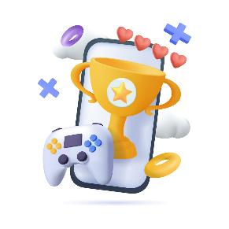
High Tech to Community Low Tech
Higher Education
Community Setting
LMS dashboards
Digital badges
App-based streaks
Analytics-driven progress tracking
Physical game formats
Group competition
Visible mastery moments
Immediate facilitator feedback
Same behavioral principles. ~ Different delivery mechanism
Notes:
On this slide, you’ll see a playful image of a mobile device with a trophy and game controller. It represents traditional, tech-driven gamification. But the real point of this slide is contrast. On the left, under Higher Education, the bullets list: LMS dashboards, Digital badges, App-based streaks, Analytics-driven progress tracking. These are common in university or corporate environments. On the right, under Community Setting, the bullets shift: Physical game formats, Group competition, Visible mastery moments, Immediate facilitator feedback. The behavioral principles are the same. The delivery mechanism changes. In community-based hospice education, we take the same behavioral principles — visible progress, structured challenge, performance feedback, social reinforcement — and translate them into human-centered formats. When engagement becomes active rather than passive, learners demonstrate competence in action. Autonomy is preserved because participation requires choice and effort. Relatedness is strengthened because learning happens in teams.

Slide 24
Translating Gamification
Community Hospice Education
Format | Educational Function | Why It Works | Behavioral Impact
Dementia Jeopardy | Retrieval practice + knowledge integration | Structured recall improves encoding; social participation reduces anxiety | Reinforces competence; increases engagement and retention
Cardiac Escape Room | Applied problem-solving under time pressure | Requires integration of symptom recognition + escalation pathways | Strengthens mastery; increases persistence through challenge
Respiratory Improvisation | Experiential rehearsal of equipment + comfort interventions | Humor lowers barriers; improvisation increases cognitive flexibility | Builds autonomy; strengthens team cohesion
Clear learning objectives I Performance-based feedback I Social reinforcement I Visible mastery moments
Notes:
This slide presents a table with four columns: Format, Educational Function, Why It Works, and Behavioral Impact. You’re seeing three different behavioral functions translated into low-tech hospice education. Let’s walk through them briefly. The first row is Dementia Jeopardy. Its educational function is retrieval practice and knowledge integration. Why it works: structured recall improves encoding, and social participation reduces anxiety. The behavioral impact is that it reinforces competence and increases engagement and retention. This format transforms a static handbook into active recall. Learners retrieve information under mild competitive pressure, receive immediate feedback, and persist because the experience is social and slightly playful. The second row is the Cardiac Escape Room. Its educational function is applied problem-solving under time pressure. It requires integration of symptom recognition and escalation pathways. The behavioral impact is strengthened mastery and increased persistence through challenge. This format mimics clinical urgency without clinical risk. Teams synthesize knowledge in real time. Mastery becomes visible. The third row is Respiratory Improvisation. Its educational function is experiential rehearsal of equipment and comfort interventions. It works because humor lowers barriers and improvisation increases cognitive flexibility. The behavioral impact is increased autonomy and stronger team cohesion. This format reduces anxiety around technical language and allows staff to explore knowledge gaps safely. Across all three examples, notice what remains constant. At the bottom of the slide you’ll see: Clear learning objectives. Performance-based feedback. Social reinforcement. Visible mastery moments. The format changes. The behavioral architecture does not. That is meaningful gamification.

Slide 25
What Persists After the Engagement?
Layer | Function | Behavioral Outcome
Engagement Activities | Active retrieval & problem-solving | Activation
Practice Sheets | Spaced repetition & fluency | Retention
Passport | Visible mastery tracking | Competence
Team Progress Bar | Collective accountability | Persistence
Notes:
This slide asks an important question: What persists after the engagement? What persists is not the activity itself. It’s the reinforcement system around it. On this slide, you’ll see a table with three columns: Layer, Function, and Behavioral Outcome. The first row is Engagement Activities. Their function is active retrieval and problem-solving. The behavioral outcome is activation. Games, scenarios, and group challenges energize learning — but activation alone is not enough. The second row is Practice Sheets. Their function is spaced repetition and fluency. The behavioral outcome is retention. Between sessions, we use low-tech reinforcement tools — word searches, matching exercises, terminology scrambles. These are not trivial activities. They create repeated, low-stakes retrieval that strengthens language fluency and concept recall. The third row is the Passport. Its function is visible mastery tracking. The behavioral outcome is competence. The passport makes progress visible across the year, not just within a single event. It tracks competency development — not attendance. The fourth row is the Team Progress Bar. Its function is collective accountability. The behavioral outcome is persistence. Instead of ranking individuals, we track team progression. The focus shifts from “Who is ahead?” to “How far have we moved together?” That preserves dignity while reinforcing shared accountability. So the games activate engagement. Practice sheets reinforce retention. The passport clarifies mastery. The team progress bar sustains persistence. Multiple reinforcement layers. That is what persists.

Slide 26

Scaling Community Education
Why Engagement Efforts Often Stall
Designed as one-time initiatives
Measured only by completion
Too complex to maintain
No feedback loop for improvement
Notes:
Up to this point, we’ve walked through the CARE framework. We’ve strengthened contextualization and active decision-making through scenarios. We’ve reinforced learning through microlearning. We’ve increased efficiency through personalization. We’ve sustained persistence through gamification and layered reinforcement. Now the question becomes: How do we make this scalable? On this slide, the image shows clinicians participating in a virtual meeting — multiple professionals on a shared screen. It represents collaboration and infrastructure. Higher education operates within established systems — learning management platforms, accreditation cycles, semester structures, analytics dashboards. There is a container that sustains engagement. Community education often does not have that container. It frequently operates through one-time workshops, in-services, grant-funded pilots, or isolated trainings. And without infrastructure, even strong engagement dissipates. The bullets on this slide outline why engagement efforts often stall: They are designed as one-time initiatives. They are measured only by completion. They are too complex to maintain. And there is no feedback loop for improvement. The problem is not lack of value. The problem is lack of system. If we want engagement to persist, it must move from event-based design to infrastructure-based design.
That is the shift we need in community settings.

Slide 27
The Scaling Model
Phase | Key Question | What You Do | What You Learn | Outcome
Pilot | Does this design activate engagement? | Implement one module, one unit, or one audience with intentional design. | Feasibility, initial learner response, workflow fit. | Proof of concept.
Measure | Is it influencing learning behavior? | Track meaningful indicators: completion, scenario accuracy, error patterns, learner feedback. | Where comprehension is strong or weak; friction points. | Data-informed insight.
Refine | How can this improve and adapt? | Adjust content, format, delivery. Translate into additional modalities (game, microlearning, worksheet, article). | Which formats increase retention and persistence. | Improved design + expanded reach.
Sustain | How does this become infrastructure? | Embed into onboarding, annual competencies, role-based pathways. | Longitudinal engagement trends. | Scalable system integration.
Notes:
This slide outlines a simple four-phase model: Pilot. Measure. Refine. Sustain. The table has five columns: Phase, Key Question, What You Do, What You Learn, and Outcome. Let’s walk through it briefly. The first phase is Pilot.
The key question is: Does this design activate engagement? You implement one module, one unit, or one learner group with intentional design. What you learn is feasibility, initial learner response, and workflow fit. The outcome is proof of concept. Start small. The second phase is Measure. The question becomes: Is it influencing learning behavior? You track meaningful indicators — completion, scenario accuracy, error patterns, learner feedback. You learn where comprehension is strong or weak, and where friction exists. The outcome is data-informed insight. The third phase is Refine. Now you ask: How can this improve and adapt? You adjust content, format, and delivery. You translate strong ideas into additional modalities — a scenario becomes a game, a game becomes microlearning, microlearning becomes a worksheet or short article. The intellectual core remains the same. The delivery adapts.
What you learn is which formats increase retention and persistence. The outcome is improved design and expanded reach. And finally, Sustain. The question shifts to infrastructure: How does this become embedded? You integrate it into onboarding, annual competencies, and role-based pathways. You monitor longitudinal engagement trends. The outcome is scalable system integration. In resource-limited community environments, scalability does not come from building more. It comes from repurposing core educational assets across formats. Efficiency enables scale. And when engagement strategies are embedded into systems, they stop being events. They become infrastructure.

Slide 28
Notes:
On this slide, you see the CARE Loop again — the same circular framework we introduced earlier, with Contextualized, Active, Reinforced, and Efficient surrounding the center of Engage, Learn, Apply. We began by naming the realities of community-based learning. Training squeezed between patient visits. Fatigue at the end of a shift. Compliance layered on compliance. Limited instructional design resources. Very little tolerance for wasted time. Those constraints are real. But they are not excuses for low-impact learning. They are design conditions. When we contextualize learning around real decisions, activate learners through retrieval and feedback, reinforce knowledge through spacing,
personalize pathways for efficiency, and structure progress so effort is visible — engagement becomes operational. And when engagement becomes operational, learning translates into practice. It begins with design. If we respect the learner’s time, we earn their attention. And when we earn their attention, we earn the opportunity to influence practice. That is what persists.

Slide 29
Pause and Reflect
What is one engagement strategy you will pilot in the next 30 days that is built on principle not just platform?
Thank you!
Notes:
The final slide reads: Pause and Reflect. What is one engagement strategy you will pilot in the next 30 days that is built on principle — not just platform? Earlier, I asked you to consider one engagement strategy that would still work, even if the technology changed. Now I’m asking you to take that one step further. What will you actually test? Start small. Measure it. Refine it. Embed it. If it survives iteration, it will survive change. Design for durability — not dependency. Thank you for building learning experiences that are not just delivered, but designed to endure.
A. “Design not platform” theme
You say variations of:
Technology is not the differentiator.
Design drives impact.
Platform is not the mechanism.
This repetition is actually strategic — but keep it to:
Slide 8
Slide 19
Slide 28
Do not re-emphasize it elsewhere.
B. Self-Determination Theory
You reference competence, autonomy, relatedness in:
Engagement slide
Gamification slide
This is fine — but do not restate the theory again in closing.
What I Would Adjust (If This Were Mine)
Very minor refinements:
A. Early Slide Energy
Make sure your opening 3–4 slides feel grounded and human — not theoretical. You want people leaning in before the framework appears.
If needed, open with a 30-second story before Slide 4.
B. Microlearning Pitfalls (Slide 16)
Keep that short. It’s a credibility slide — not a scolding slide.
Engagement must be designed around decision-making.
Reinforcement — not exposure — drives retention.
Scalability requires infrastructure, not events.

Slide 30
References
Chaker, R., Hajj-Hassan, M., & Ozanne, S. (2024). The effects of online continuing education for healthcare professionals: A systematic scoping review. Open Education Studies, 6(1), 20220226. https://doi.org/10.1515/edu-2022-0226
Cook, D. A., et al. (2013). Internet-based learning in the health professions: A meta-analysis. JAMA, 300(10), 1181–1196. https://doi.org/10.1001/jama.300.10.1181
Deci, E. L., & Ryan, R. M. (2000). The “what” and “why” of goal pursuits: Human needs and the self-determination of behavior. Psychological Inquiry, 11(4), 227–268.
Dichev, C., & Dicheva, D. (2017). Gamifying education: What is known, what is believed and what remains uncertain. International Journal of Educational Technology in Higher Education, 14, 9. https://doi.org/10.1186/s41239-017-0042-5
Fontaine, G., Cossette, S., Maheu-Cadotte, M.-A., et al. (2019). Efficacy of adaptive e-learning for health professionals and students: A systematic review and meta-analysis. BMJ Open, 9, e025252. https://doi.org/10.1136/bmjopen-2018-025252
Hew, K. F. (2014). Promoting engagement in online courses: What strategies can we learn from three highly rated MOOCs. British Journal of Educational Technology, 47(2), 320–341. https://doi.org/10.1111/bjet.12235
Li, L., Hew, K. F., & Du, J. (2024). Gamification enhances student intrinsic motivation, perceptions of autonomy and relatedness, but minimal impact on competency: A meta-analysis and systematic review. Educational Technology Research and Development, 72, 765–796. https://doi.org/10.1007/s11423-023-10337-7

Slide 31
References
Means, B., Toyama, Y., Murphy, R., Bakia, M., & Jones, K. (2010). Evaluation of evidence-based practices in online learning: A meta-analysis and review of online learning studies. U.S. Department of Education.
Meyer, A., Rose, D. H., & Gordon, D. (2014). Universal design for learning: Theory and practice. CAST Professional Publishing.
Moore, R. L., Hwang, W., & Moses, J. D. (2024). A systematic review of mobile-based microlearning in adult learner contexts. Educational Technology & Society, 27(1), 137–146. https://www.jstor.org/stable/48754847
Roediger, H. L., & Butler, A. C. (2011). The critical role of retrieval practice in long-term retention. Trends in Cognitive Sciences, 15(1), 20–27. https://doi.org/10.1016/j.tics.2010.09.003
Sailer, M., & Homner, L. (2020). The gamification of learning: A meta-analysis. Educational Psychology Review, 32, 77–112. https://doi.org/10.1007/s10648-019-09498-w
Sitzmann, T. (2011). A meta-analytic examination of the instructional effectiveness of computer-based simulation games. Personnel Psychology, 64(2), 489–528. https://doi.org/10.1111/j.1744-6570.2011.01190.x
Sweller, J. (1988). Cognitive load during problem solving: Effects on learning. Cognitive Science, 12(2), 257–285. https://doi.org/10.1207/s15516709cog1202_4
Van Merriënboer, J. J. G., & Kirschner, P. A. (2018). Ten steps to complex learning: A systematic approach to four-component instructional design (3rd ed.). Routledge.

