Slide 1




Enhancing Organizational Engagement
First Friday Education and Professional Development
  Donna M. Fahey, MSN, MFA, RN, AHN-BC, CHPN, CNL
  Director, Boccolini Institute

Slide 2

Presentation Road-Map
Part 1: Context
Part 2: Intervention
Part 3: Operations
Part 4: Evaluation
Part 5: Interpretation
Part 6: Application
Part 7: Future Direction
Context | Intervention | Operations | Evaluation | Interpretation | Application | Future Direction

Slide 3
Learning Objectives
At the conclusion of this session, participants will be able to:
Describe the core structural elements of the First Friday interprofessional education model.
Explain how recurring, facilitated learning spaces can influence team cohesion and professional wellbeing in hospice settings.
Identify at least three measurable indicators of organizational engagement beyond attendance and satisfaction.
Outline one practical step to strengthen interprofessional learning culture within their own organization
Context | Intervention | Operations | Evaluation | Interpretation | Application | Future Direction

Slide 4
Setting the Stage: Why This Matters Now
Hospice & Palliative Care Teams Are:
Managing increasing clinical complexity
Working across settings with limited structural connection
Experiencing workforce strain and burnout
Participating in education that informs – but not always relationally structured
Do you recognize this pattern—strong clinicians – thin connections?
Where do your teams regularly come together to learn and reflect?
Context | Intervention | Operations | Evaluation | Interpretation | Application | Future Direction

Slide 5
Why First Friday?
Clinicians are asking for regular, meaningful education, not just one‑off lectures.
Managers notice clinical uncertainty around complex cases.
The organizational is growing and changing.
What if education could strengthen connection — not just competence?
What would happen if we created a predictable space where people from different disciplines could come together regularly to learn, reflect, and talk?
Context | Intervention | Operations | Evaluation | Interpretation | Application | Future Direction

Slide 6
Pause and Reflect
Are there currently any similarities on the micro level in your own settings?
Can you identify similar relational gaps in your current education structure?
Context | Intervention | Operations | Evaluation | Interpretation | Application | Future Direction

Slide 7
The Intervention
The core structural elements of the First Friday interprofessional education model

Slide 8
First Friday in Context: Mapping Established Learning Models
MODEL | CORE MECHANISM | WHAT FIRST FRIDAY ADOPTS
Project ECHO | Case-based learning communicates with recurring cadence | Predictable rhythm of learning + interdisciplinary participation
Schwartz Rounds | Facilitated reflection on emotional and relational aspects of care | Physiological safety and space for dialogue
CAPC Office Hours / Grand Rounds | Recurring expert-informed learning discussions | Clinical competence reinforcement and shared language
First Friday | Internal Interdisiplinary learning ecosystem | Culture-building trough predictable shared reflection
Shared Design Elements: Predictable Cadence, Interdisciplinary Dialogue, Psychological Safety, Community Learning
Context | Intervention | Operations | Evaluation | Interpretation | Application | Future Direction

Slide 9
What is First Friday?
A recurring, interprofessional education and professional development initiative designed to:
  Create predictable shared learning space
  Strengthen interdisciplinary dialogue
  Reinforce clinical competence
  Support professional identity and wellbeing
Operational Structure:
  Monthly cadence
  Live, facilitated sessions
  Rotating formats
  Ongoing evaluation
Context | Intervention | Operations | Evaluation | Interpretation | Application | Future Direction

Slide 10

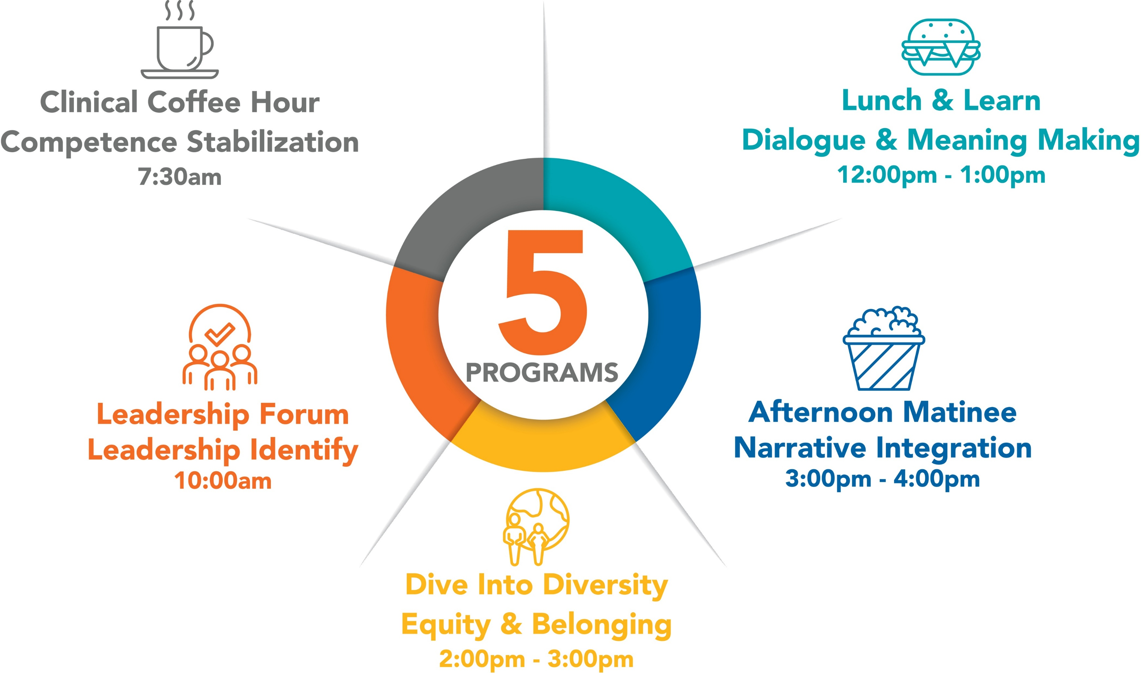
Each modality addresses a different dimension of culture – but all operate within the same predictable structure.

Slide 11
Pause and Reflect
Think about a time when something you learned in conversation with colleagues, maybe a story, a phrase, or an example, stayed with you and influenced how you approached a patient or family later.
What made that moment stick?
Was it the information… or was it the people and the setting where you encountered it?
Context | Intervention | Operations | Evaluation | Interpretation | Application | Future Direction

Slide 12
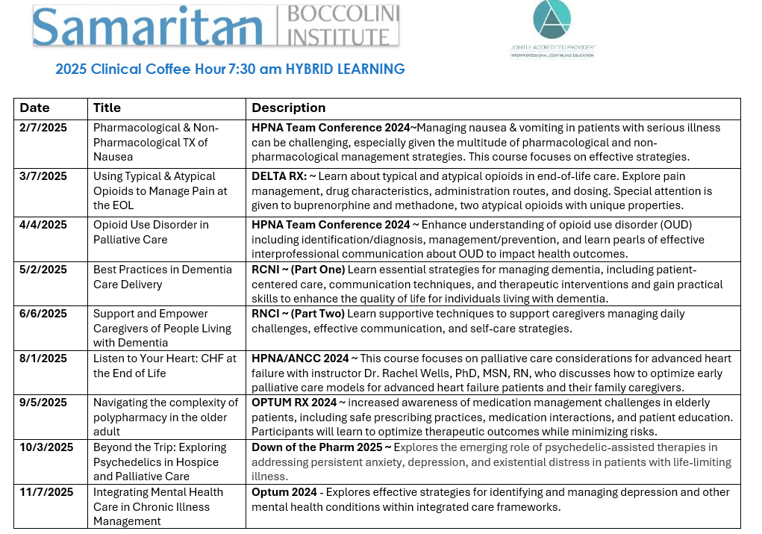
Context | Intervention | Operations | Evaluation | Interpretation | Application | Future Direction

Slide 13
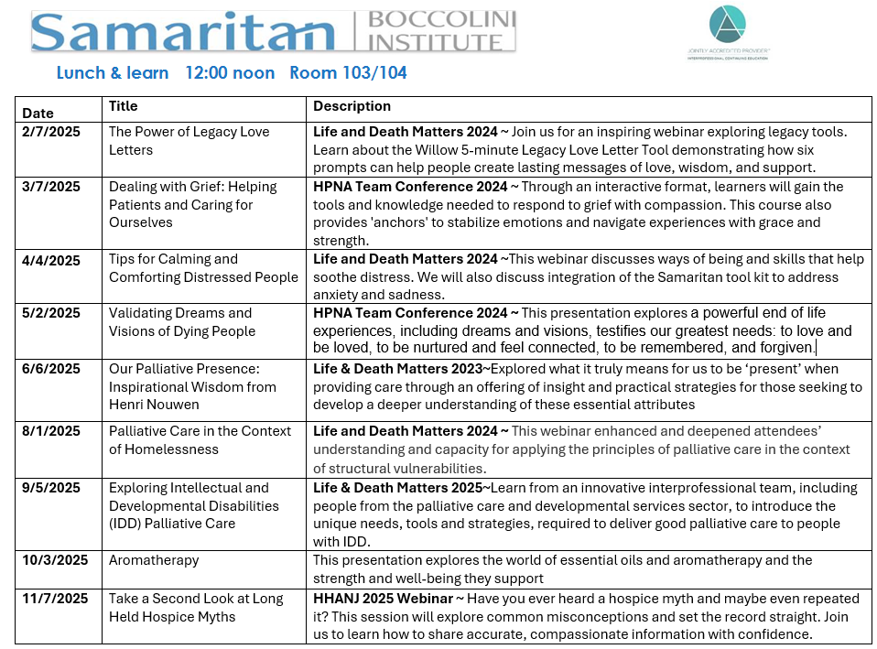
Context | Intervention | Operations | Evaluation | Interpretation | Application | Future Direction

Slide 14
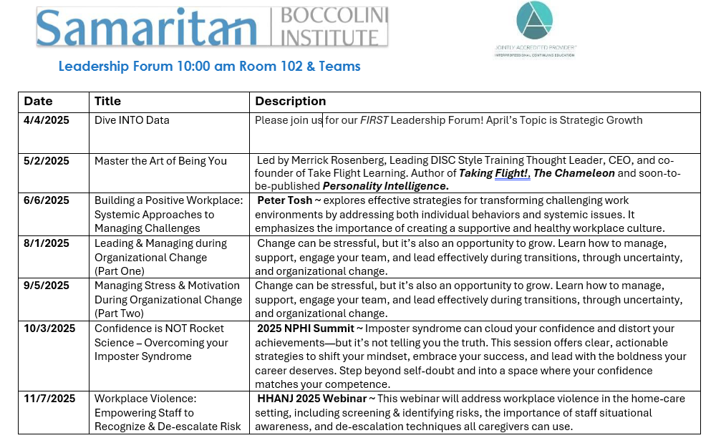
Context | Intervention | Operations | Evaluation | Interpretation | Application | Future Direction

Slide 15
Afternoon Matinee (2025 Series)
May 2, 2025 ~ The Interdisciplinary Team (IDT): Roles and Responsibilities
Samaritan’s first training video on the Roles & Responsibilities of the Interprofessional Team. Featuring: Angela Marinucci, Charity Jones, Charlie Massaquoi, Chrissy Stout, Joe DeSantis, Kim Rumaker, Lisa DiCerta, Marci DeCosmo, Sara Pagliaro, Shery Fosay, and Theresa Robinson
August 1, 2025 ~ Caregiving
Executive Producer Bradley Cooper ~ the story of paid and unpaid caregivers navigating the challenges and joys of this deeply meaningful work. Intertwining intimate personal stories with the untold history of caregiving, the documentary reveals the state and the stakes of care in America today.
Context | Intervention | Operations | Evaluation | Interpretation | Application | Future Direction

Slide 16
Dive into Diversity
February 2025 ~ DIVERSITY BOOK CLUB - BLACK HISTORY MONTH
A Good Cry: What we Learn From Tears and Laughter, A book of poetry and prose by Nikki Giovanni
OCTOBER 2025 ~ HARVESTING DIVERITY
Bring your favorite side dish, snack, or dessert to share a cultural heritage, then stop in to connect over great food, great friends, and relaxed conversation
**HPNF Diversity in Health Care Series** https://www.youtube.com/playlist?list=PL49Ueck36ETjYW00KIpgl_BU8bOhvyKGd
Context | Intervention | Operations | Evaluation | Interpretation | Application | Future Direction

Slide 17
Design Principles
Predictable cadence – they happen regularly
Interprofessional planning – more than one discipline shapes the content
Facilitated dialogue – conversation is central, not optional
Multiple formats – clinical, leadership, narrative, equity
Ongoing evaluation – we listen and adapt
Context | Intervention | Operations | Evaluation | Interpretation | Application | Future Direction

Slide 18
Why Friday?
No perfect day for clinicians
Predictability reduces decision fatigue
End-of-week reflection space
A memorable organizational rhythm
Context | Intervention | Operations | Evaluation | Interpretation | Application | Future Direction

Slide 19
Operational Reality
How First Friday Functions within a Hospice & Palliative Care Organization

Slide 20
Enabling Conditions: Leadership & Culture
Operational leadership visibility
Recognized need for reoccurring interdisciplinary education
Organizational growth and desire to preserve culture
Willingness to begin imperfectly and adapt in real time
Context | Intervention | Operations | Evaluation | Interpretation | Application | Future Direction

Slide 21
Operational Reality: Running the Series
Five programs operating within one recurring structure
Approximately 40 educational programs annual across the department
Shared facilitation across disciplines
Content curation rather than content creation
Occasional scheduled adjustments (holidays, workload realities)
Context | Intervention | Operations | Evaluation | Interpretation | Application | Future Direction

Slide 22
Where the Learning Content Comes From
Curated content rather than original lectures
CAPC resources and webinars
Interdisciplinary education programs (e.g., Life & Death Matters, Canada)
Leadership developmental resources (LMS, Ted Talks, YouTube)
Context | Intervention | Operations | Evaluation | Interpretation | Application | Future Direction

Slide 23
Delivery Formats (Virtual, In-Person, Hybrid)
PROGRAM | FORMAT
Clinical Coffee Hour | Initially Hybrid – Now Virtual
Lunch & Learn | In-person – Now Hybrid
Leadership Forum | Hybrid
Afternoon Matinee | In-person
Dive Into Diversity | Hybrid
Context | Intervention | Operations | Evaluation | Interpretation | Application | Future Direction

Slide 24
What Changed?
How structured learning shapes team cohesion and organizational engagement

Slide 25
Pause and Reflect
How do you know whether a learning activity is making a difference?
Are you measuring relational outcomes like connection, cohesion, or belonging?
Or mostly operational metrics like attendance and satisfaction?
Context | Intervention | Operations | Evaluation | Interpretation | Application | Future Direction

Slide 26
Measurement Strategy
Attendance & Participation Trends
Continuing Education Credits Awarded
Quarterly Engagement Indicators
  Team cohesion
  Job satisfaction
  Overall wellbeing
Open-ended Qualitative Feedback
Follow-up surveys assessing practice application
ATTENDANCE TENSION - “With competing demands of the department and patient care, consistent attendance has been challenging.”

Slide 27
Quantitative Snapshot
Average Scores (Quarterly Data 1-10 scale):
Team Cohesion: 7.0
Job Satisfaction: 6.57
Overall Wellbeing: 6.71
Then one interpretive line:
Positive correlation observed between participation and engagement indicators
Context | Intervention | Operations | Evaluation | Interpretation | Application | Future Direction

Slide 28
Qualitative Themes and Practice Activation
Emerging Themes:
  Increased organizational belonging
  Strengthened interdisciplinary respect
  Reinforcement of clinical confidence
Practice Activation Examples:
  Preparedness in managing intractable nausea
  Integration of tools (e.g., Legacy Letters)
  Increased cross-role consultation
APPLIED CONFIDENCE - “The sessions have reaffirmed my knowledge base and created opportunities for meaningful sharing across disciplines.”
Context | Intervention | Operations | Evaluation | Interpretation | Application | Future Direction

Slide 29
INTERPRETATION
The Cultural Signals

Slide 30
Emerging Cultural Themes**
Across modalities, participants described:
Stronger sense of organizational belonging
Increased interdisciplinary respect
Reinforced clinical and professional identity
Greater comfort discussing uncertainty
Desire for continued structured dialogue
Reflective Observations
Education as belonging
Education as moral distress buffer
Psychological safety in ethical uncertainty
Non-clinical inclusion gap
ORGANIZATIONAL BELONGING - “These sessions have helped me meet others beyond my field team and contributed to my feeling part of the larger organization.”
INTERPROFESSIONAL RESPECT - “This content is relevant to all disciplines. It is important for the medical side to learn about the support side — and vice versa.”
Context | Intervention | Operations | Evaluation | Interpretation | Application | Future Direction

Slide 31
What Surprised Us
Predictability mattered more than topics
Participants asked for more dialogue not less
Curated content worked better than original lectures
Different modalities required different delivery formats
Context | Intervention | Operations | Evaluation | Interpretation | Application | Future Direction

Slide 32
What Makes This Work Culturally?
Cultural Mechanism
Shared rhythm reduces relational distance
Dialogue surfaces diverse clinical perspectives
Reflection normalizes uncertainty in serious illness care
Repeated interaction strengthens organizational belonging
Context | Intervention | Operations | Evaluation | Interpretation | Application | Future Direction

Slide 33
Implications for Workforce Wellbeing
Psychological Safety & Moral Distress
Recurring interprofessional reflection may reduce professional isolation
Facilitated dialogue supports ethical processing in complex care
Predictable learning spaces can reinforce professional identity
Clinical Confidence in Symptom Management
Applied practice examples (e.g., intractable nausea preparedness)
Reinforcement of evidence-based approaches
Shared clinical language across disciplines
Interprofessional Respect & Role Clarity
Increased understanding of roles and contributions
Strengthened collaborative communication
Reinforcement of shared responsibility in serious illness care
Education intentionally designed as relational infrastructure may contribute to workforce stability and collaborative excellence in hospice care.
Edmondson, 1999; National Academy of Medicine, 2019; Reeves et al., 2017; Rushton, 2018; West et al., 2018
Context | Intervention | Operations | Evaluation | Interpretation | Application | Future Direction

Slide 34
APPLICATION
Practical steps to strengthen interprofessional learning culture

Slide 35
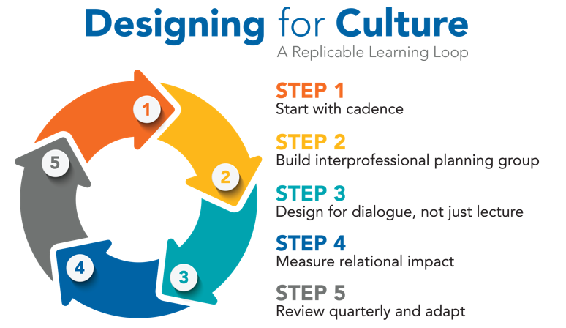
Normalization Process Theory suggest recurring collaborative practices become embedded when participants collectively understand, engage in, enact, and evaluate the activity (May & Finch, 2009).

Slide 36
Beyond Attendance: What to Measure
If education is meant to influence culture, measure:
  Applied Clinical Confidence
  Cross-Role Understanding & Respect
  Organizational Belonging
  Psychological Safety Indicators
  (Optional) Intent to Change Practice
Context | Intervention | Operations | Evaluation | Interpretation | Application | Future Direction

Slide 37
Evaluation Tools Used Across the Program
Practical Application
Relevance of content, perceived value, and how to apply the knowledge
Anticipated barriers to implementing new knowledge to professional practice
Team-Based Learning
Identify at least one team role or viewpoint you learned about in today's session
What is one way team members can work better together on this topic?
What is one idea you will use to help your team care for patients/families or others?
Organizational Culture
Impact on sense of cohesion with team/organization? / job satisfaction? / wellbeing?
Impact on sense of belonging, engagement, and/or relationships
Context | Intervention | Operations | Evaluation | Interpretation | Application | Future Direction

Slide 38
One Practical Step
What is one structural shift that feels realistic in your setting?
If you could change one thing in the next 90 days - consider:
  Add 10 minutes of facilitated dialogue to an existing CE session
  Track one belonging or cohesion metric
  Establish a recurring monthly learning rhythm
  Create an interprofessional planning conversation
Implementation worksheet available in handout.
Context | Intervention | Operations | Evaluation | Interpretation | Application | Future Direction

Slide 39
Future Direction
The Broader Context

Slide 40
What we Would Do Differently
Start with baseline measures
– Establish engagement indicators (belonging, cohesion, wellbeing) before launch
Plan for broader organizational interest
– Anticipate cross-disciplinary participation beyond the original department
Design for iteration from the beginning
– Expect the program to evolve and adapt over time
Context | Intervention | Operations | Evaluation | Interpretation | Application | Future Direction

Slide 41
Questions We Are Still Exploring
How does recurring interdisciplinary learning influence long-term workforce wellbeing?
Which structural elements have the greatest impact – cadence, dialogue, or interdisciplinary design?
How does participation influence clinical practice over time?
What indicators best capture relational culture within hospice and palliative care teams.
How can non-clinical team members can be more fully included?
  Example: Hospice Office Hours
Context | Intervention | Operations | Evaluation | Interpretation | Application | Future Direction

Slide 42
Reframing Education
Education can transfer knowledge.
Education can strengthen connection.
In hospice and palliative care, both matter.
When learning spaces are intentionally designed, education can become part of the relational fabric of the team.
Context | Intervention | Operations | Evaluation | Interpretation | Application | Future Direction

Slide 43
Key Takeaways
Strong clinicians still need shared reflection space.
Predictable learning structures can create that space.
Recurring spaces may strengthen connection and belonging.
Context | Intervention | Operations | Evaluation | Interpretation | Application | Future Direction

Slide 44
Closing Reflection
What resonated most with your experience?
Where might structured reflection fit within your organization?
What is one small structural change you could try in the next 90 days?
Context | Intervention | Operations | Evaluation | Interpretation | Application | Future Direction

Slide 45
References
Edmondson, A. C. (1999). Psychological safety and learning behavior in work teams. Administrative Science Quarterly, 44(2), 350–383. https://doi.org/10.2307/2666999
May, C., & Fitch, T. (2009). Implementing, embedding, and integrating practices: An outline of normalization process theory. Sociology, 43(3), 535-554. https://doi.org/10.1177/0038038509103208
National Academy of Medicine. (2019). Taking action against clinician burnout: A systems approach. The National Academies Press. https://doi.org/10.17226/25521
Reeves, S., Pelone, F., Harrison, R., Goldman, J., & Zwarenstein, M. (2017). Interprofessional collaboration to improve professional practice and healthcare outcomes. Cochrane Database of Systematic Reviews, (6), CD000072. https://doi.org/10.1002/14651858.CD000072.pub3
Rushton, C. H. (2018). Moral resilience: Transforming moral suffering in healthcare. Oxford University Press.
West, C. P., Dyrbye, L. N., & Shanafelt, T. D. (2018). Physician burnout: Contributors, consequences and solutions. Journal of Internal Medicine, 283(6), 516–529. https://doi.org/10.1111/joim.12752

Slide 46
THANK YOU

